Slide 1
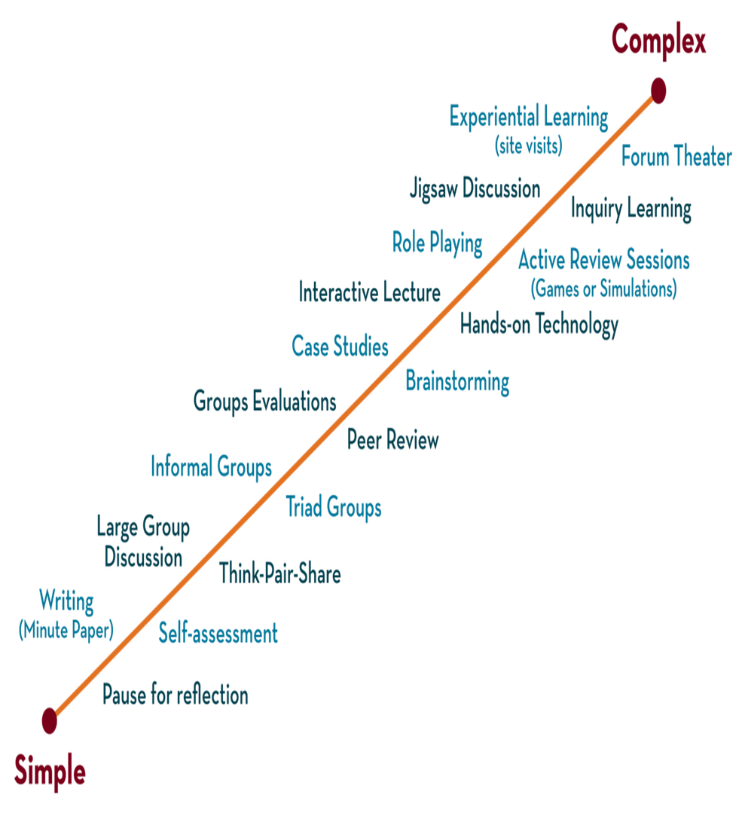
Department of CSE
DESIGN AND ANALYSIS OF ALGORITHMS
24CS2203
Topic:
Greedy Method
General Method

Slide 2
for (int i = 0; i < 3; i++) {
for (int j = 0; j < 2; j++) {
printf("%d %d\n", i, j);
}
}
for (int i = 0; i < A; i++) {
for (int j = 0; j < B; j++) {
// code
}
}
for (int n = 0; n < A * B; n++) {
int i = n / B; // Outer loop index
int j = n % B; // Inner loop index
// code equivalent to the original
}
int A = 3;
int B = 2;
for (int n = 0; n < A * B; n++)
{
int i = n / B;
int j = n % B;
printf("%d %d\n", i, j);
}
Effective when the logic within the loops is independent of the loop structure. For more complex scenarios, particularly when loop boundaries or conditions depend on previous iterations, a more custom conversion would be necessary.

Slide 3
Basic Notations
A feasible solution is any subset of the original input that satisfies a given set of constraints.
An objective function is an input for which a feasible solution can be obtained that either maximizes or minimizes.
An optimal solution is a feasible solution that maximizes or minimizes the objective function. For a given problem, there can be only one optimal solution.

Slide 4
Optimization Problem
Optimization problems are those for which the objective is to Maximize or Minimize some values. For example,
Finding the minimum number of colors needed to color a given graph.
Finding the shortest path between two vertices in a graph
Strategies used for optimization problems:
Greedy method
Dynamic programming
Branch and Bound

Slide 5
Greedy Method
The greedy algorithm obtains an Optimal solution by making a sequence of decisions.
Every greedy-based problem will be given a set of inputs and constraints.
Our objective is to find a solution vector that satisfies a set of constraints.
Decisions are made one by one in some order.
Each decision is made using a greedy-choice property or greedy criterion.

Slide 6
Greedy Choice Property
Global Optimal Solutions will be made with local optimal (Greedy) choices
In the Greedy algorithm, the best choice will be selected at the moment to solve the sub-problem that remains
The choice of the greedy may depend on the previous choices made but it cannot depend on future choices or the solutions to the sub-problems

Slide 7
Types of Greedy Problems
Subset Paradigm: To solve a problem (or possibly find the optimal/best solution), a greedy approach generates a subset by selecting one or more available choices.
Example:
Knapsack problem
Job sequencing with deadlines

Slide 8
Control abstraction for subset paradigm
Greedy(a,n) // a[1:n] contains the n inputs
{
solution= ϕ // Initialize solution
for i=1 to n do
{
x := Select(a);
if Feasible(solution , x) then
solution=Union(solution , x)
else
reject(); //if solution is not feasible
}
return solution;
}

Slide 9
Three important activites
Selection: Selection of solution from a[] and removing it
Feasibility: Feasible(solution,x) is a Boolean function to determine whether x can be included into the solution vector
Optimality: From the set of feasible solutions, the particular solution that minimizes or maximizes the given objective function

Slide 10
Applications
Knapsack Problem
Job Sequencing with deadlines
Minimum cost spanning tree (Prims and Kruskals)
Huffman Codes
Single source shortest path problem

Slide 11
Limitations
The greedy algorithm makes judgments based on the information at each iteration without considering the broader problem; hence it does not produce the best answer for every problem.
The problematic part of a greedy algorithm is analyzing its accuracy. Even with the proper solution, it is difficult to demonstrate why it is accurate.
Optimization problems (Dijkstra’s Algorithm) with negative graph edges cannot be solved using a greedy algorithm.

Slide 12
Divide and conquer | Greedy Algorithm
Divide and conquer is used to find the solution, it does not aim for the optimal solution. | A greedy algorithm is optimization technique. It tries to find an optimal solution from the set of feasible solutions
DC approach divides the problem into small sub-problems, each sub-problem is solved independently and solutions of the smaller problems are combined to find the solution to the large problem. | In greedy approach, the optimal solution is obtained from a set of feasible solutions.
Sub problems are independent, so DC might solve same sub problem multiple time. | Greedy algorithm does not consider the previously solved instance thus it avoids the re-computation.
DC approach is recursive in nature, so it is slower and inefficient. | Greedy algorithms are iterative in nature and hence faster.
Divide and conquer algorithms mostly runs in polynomial time | Greedy algorithms also run in polynomial time but takes less time than Divide and conquer
Example: Merge sort, Quick sort | Example: Knapsack problem, Job scheduling problem

